Slide 1
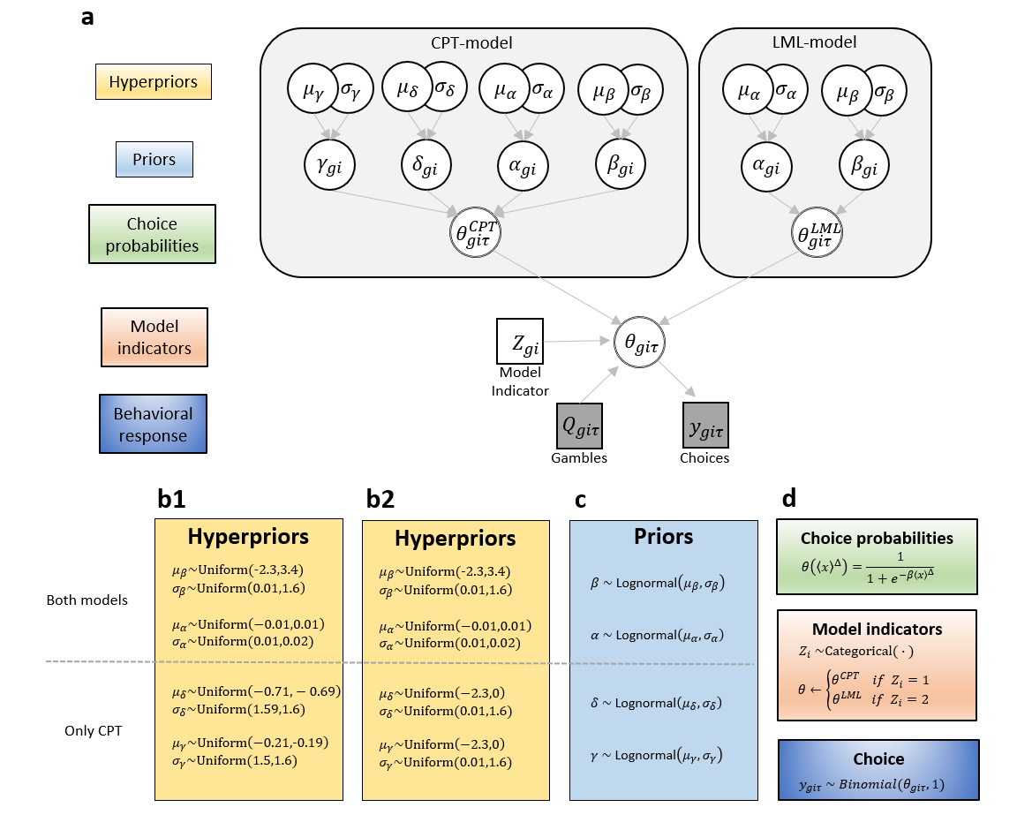
Models

Slide 2
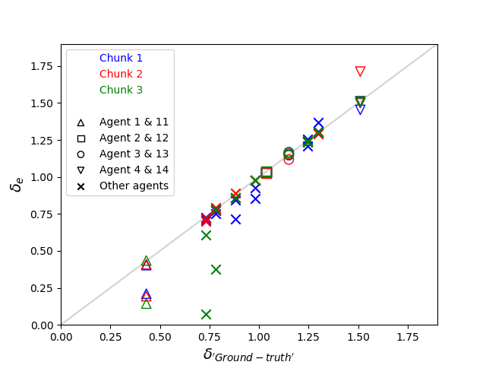
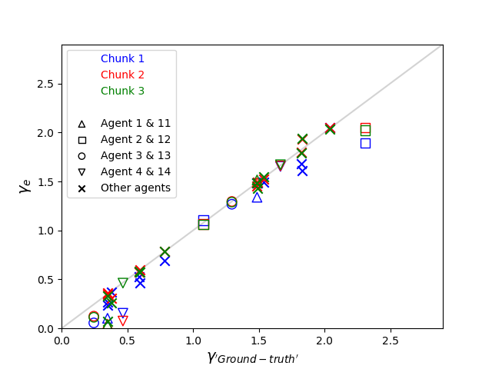

CPT-agents; $δ_{GT} vs. δ_{e}$ and $γ_{GT} vs. γ_{e}$

Slide 3
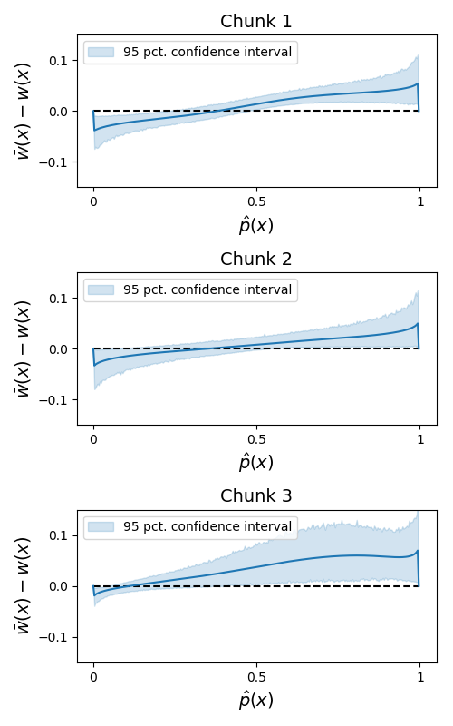
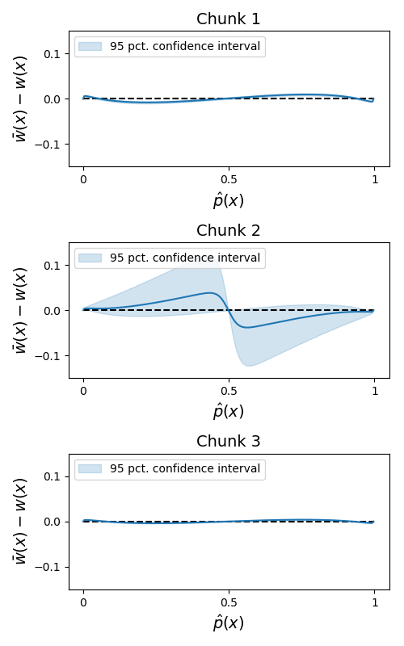
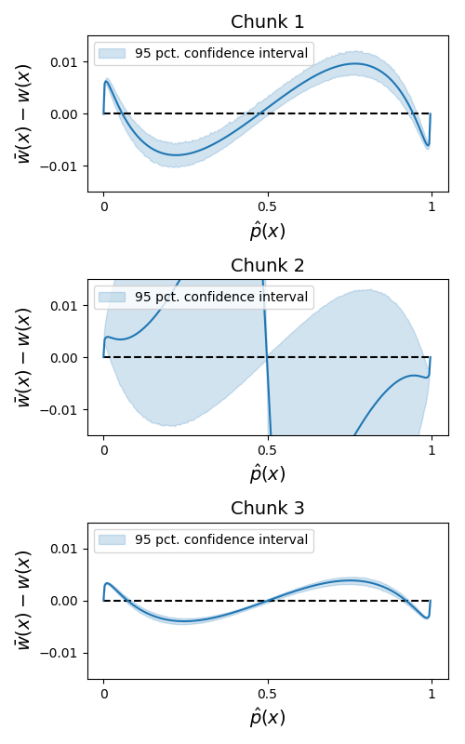
LML-agents
CPT-agents

Slide 4
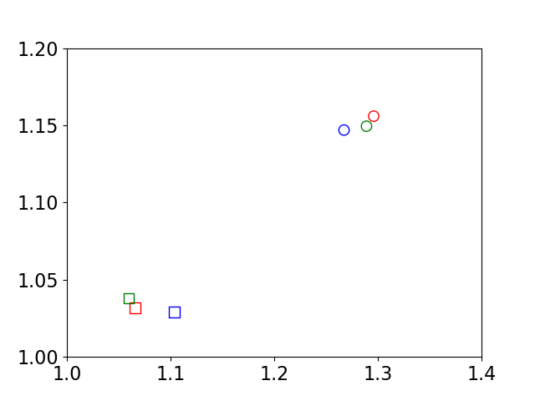
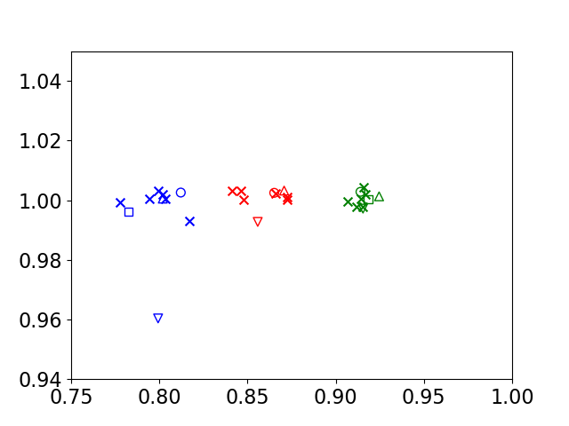
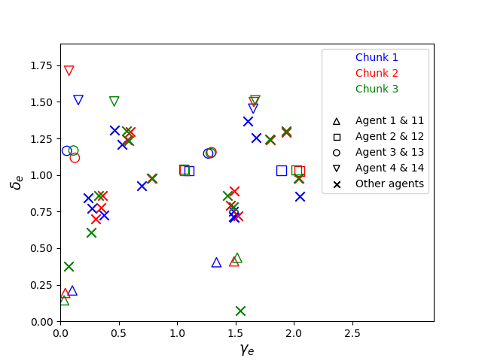
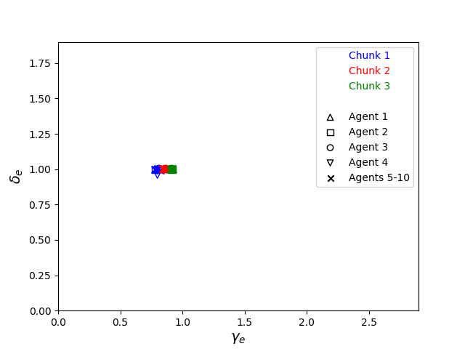
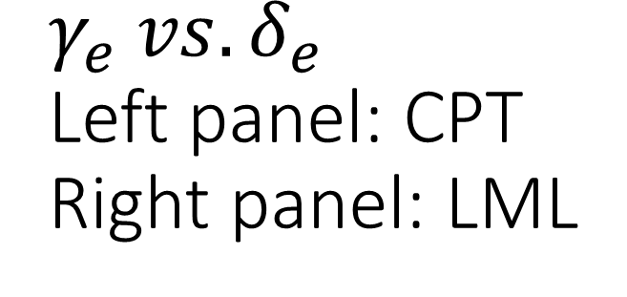
$$γ_{e} vs. δ_{e}$$ Left panel: CPT Right panel: LML

Slide 5
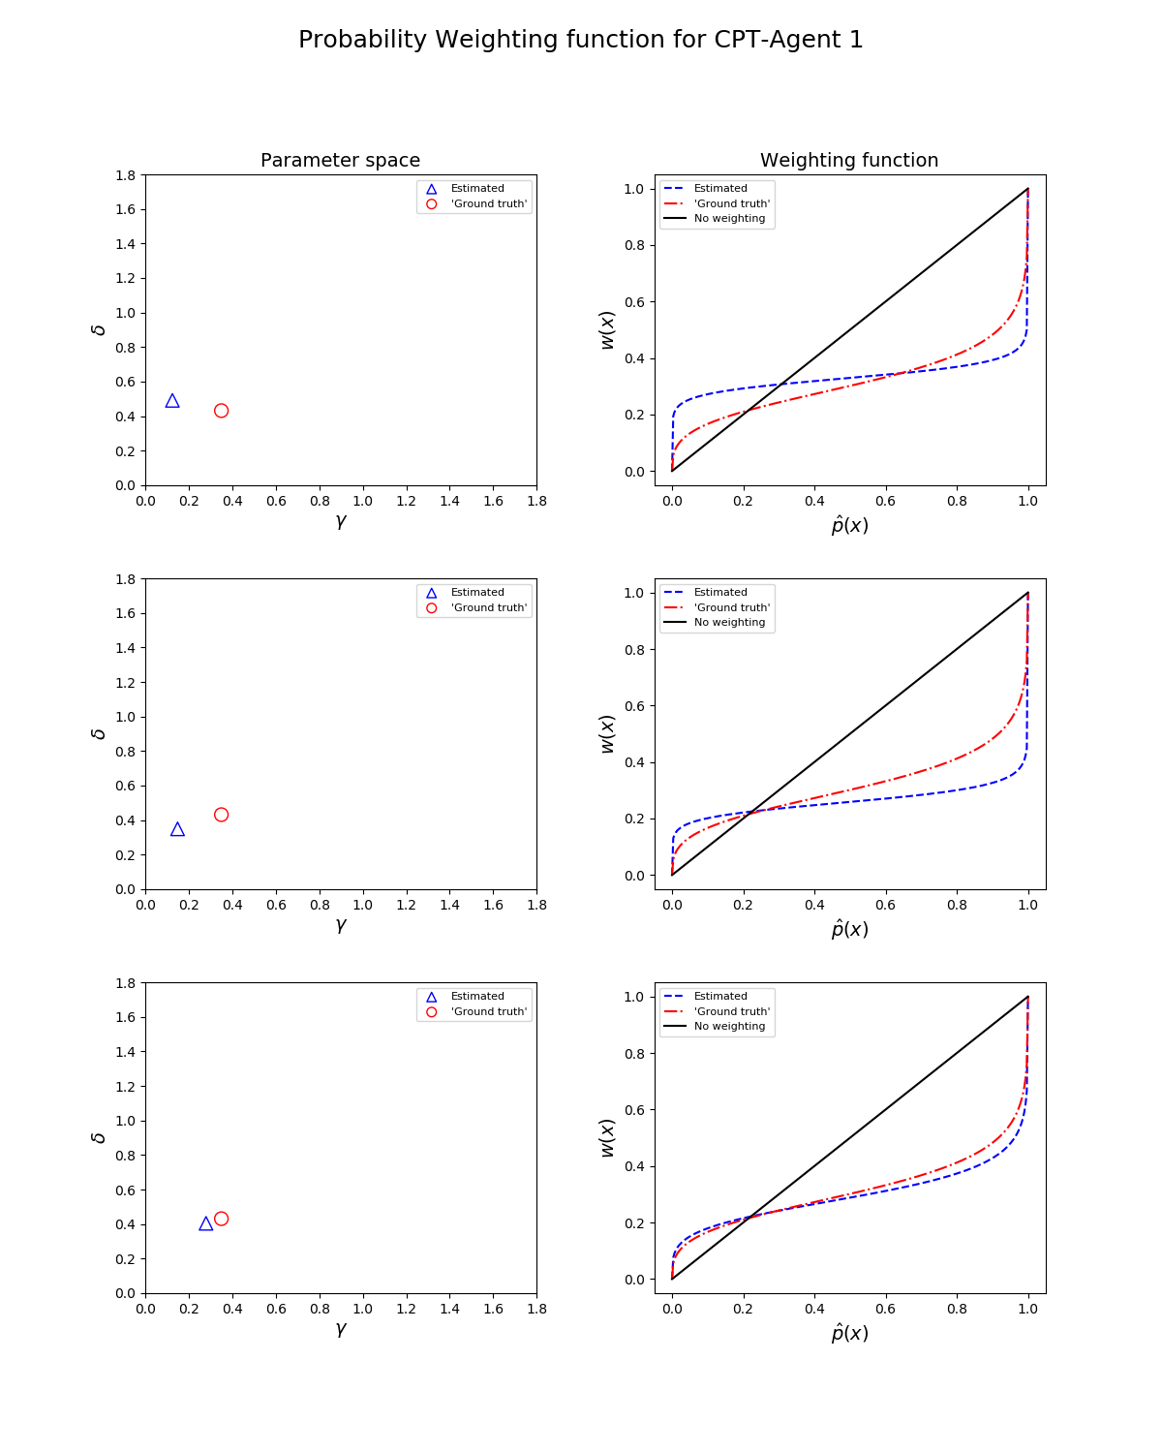
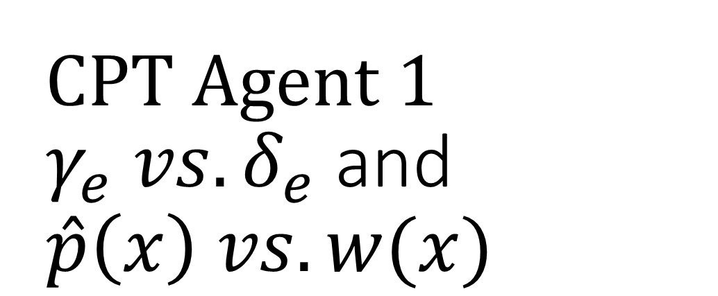
CPT Agent 1 $γ_{e} vs. δ_{e}$ and $\hat{p}\left(x\right) vs. w(x)$

Slide 6
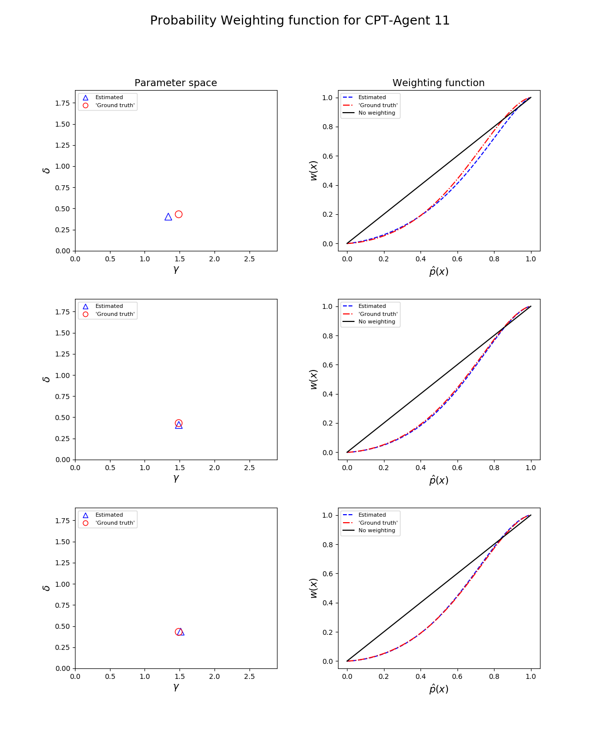
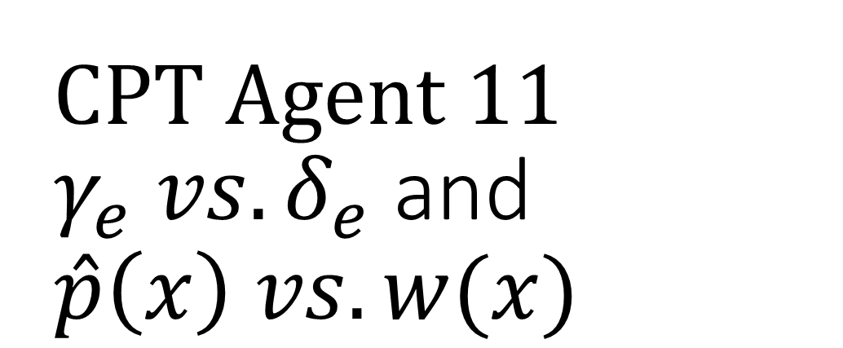
CPT Agent 11 $γ_{e} vs. δ_{e}$ and $\hat{p}\left(x\right) vs. w(x)$

Slide 7
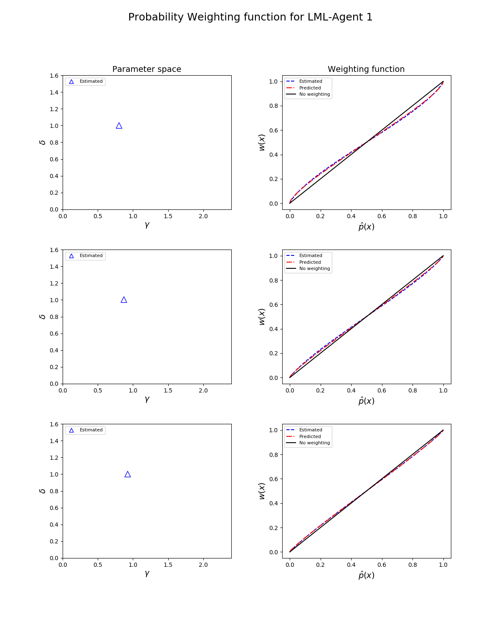
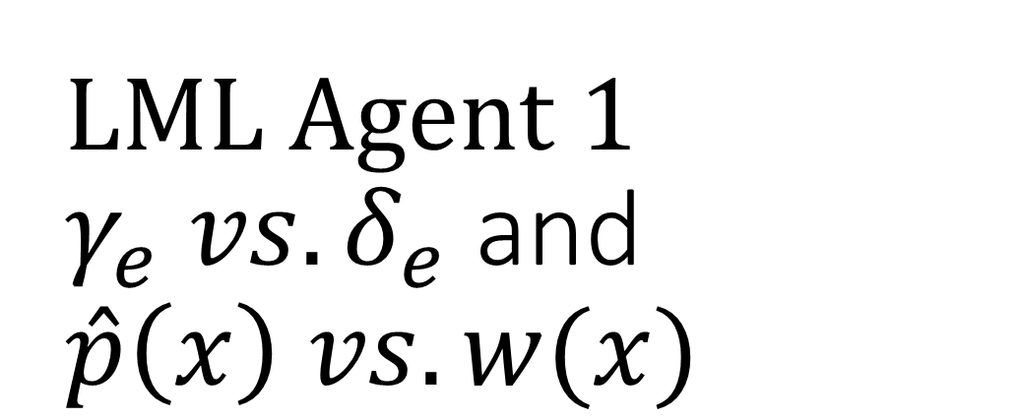
LML Agent 1 $γ_{e} vs. δ_{e}$ and $\hat{p}\left(x\right) vs. w(x)$

Slide 8
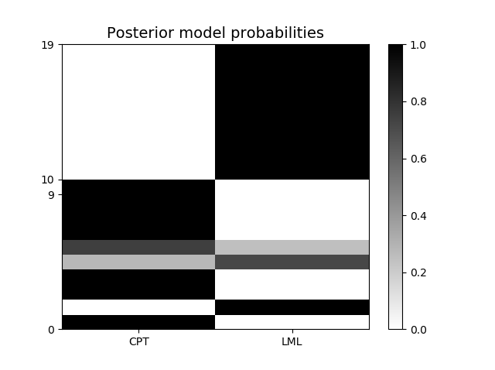
Model selection

